Slide 1

Using User Reviews to Enrich Social Recommender Systems
Ahmad Jawaad Shah - 218029400
University of KwaZulu-Natal
Research Project Presentation (Nov 2021)
Notes:
Good day. My name is Ahmad Jawaad Shah, from the University of KwaZulu-Natal, and this is a presentation of my research project titled Using user reviews to enrich social recommender systems.

Slide 2

Presentation Outline
Abstract
Introduction
Review of Previous Work
Proposed Model
Evaluation
Conclusions and Future Work
Acknowledgements and References
Software Demonstration
Notes:
The overall presentation is structured in the following way. First we discuss the abstract, thereafter we follow that up with an introduction into recommender systems in Section 1 and 2 respectively. Section 3 discusses previous work done in this domain. Section 4 explores the design and architecture of the proposed model. Thereafter, we move onto the evaluation of the model in Section 5. To close of this presentation, we conclude by providing future directions for work to be done in the recommender domain, acknowledgement of notable contributors and references used, and we provide a software demonstration of the proposed model in action

Slide 3

1. Abstract
This portion of the presentation is aimed at giving a brief overview of the project, its motivation, key ideas and results.
Notes:
We begin with the abstract.

Slide 4

1. Abstract
Recommender systems have become increasingly popular in the online domain and play a critical role in suggesting information of interest to users. Various techniques have been explored while implementing these systems, such as collaborative filtering, content-based filtering and preference-based solutions. In recent times, personal data has become ubiquitous and has prompted researchers to explore avenues that use user reviews on items of interest and social relationships to improve output recommendations. Furthermore, to the foregoing, the immense interest in Neural Networks has provided a platform for applying deep learning techniques to improve existing recommender system solutions. In this paper, we present a novel deep neural network framework (RevNet) for social recommendations through the utilization of user reviews. The model captures the user-user and user-item spaces typically found in a social recommender, as well as adds another dimension in the form of a user-review space. In this regard, in the user-review space, we aim to capture the reviews provided by users on items. Thus, we propose to employ the use of doc2vec representations of user reviews on items which will be incorporated into a neural network for ratings prediction. Evaluation of the proposed solution on a real-world dataset, shows that the inclusion of user reviews in a social recommender system are effective
Notes:
So, what is the purpose of our research?
Recommender systems play a critical role nowadays in many ecommerce sites, and its overall presence in the online domain is always felt. And with the ease of access to user data there has been a shift from standard recommender systems to the new state of the art social recommender systems which utilize a users social relations with others. Coupled with that, the immense interest NN has provided a platform whereby we can use these architectures to improve previous solutions.
With all of the above taken into consideration, we propose a DNN framework for social recommendations called RevNet. In particular, this architecture contains the components found in a social recommender as well as adds another dimension in the form of a user-review space, where we employ the use of text reviews to capture the sentiment of a user towards and item. To facilitate this, we utilize doc2vec paragraph vectors for text representation.
To evaluate the model, we apply it to a real-world dataset, from which the results indicate that the addition is effective.

Slide 5
2. Introduction
In this section of the presentation, we will focus on the motivation behind recommender systems, provide a brief overview of the current trends as well as define our contribution towards this domain
Notes:
Now that we have a general idea of the project, we can now discuss recommender systems in fine detail.

Slide 6
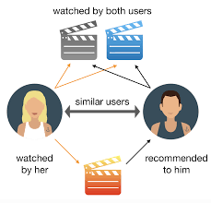
What are Recommender Systems? Why do we need them?
Recommender systems are systems that are designed to either recommend items to users or predict a rating that a user would give to an item.
These systems help us overcome the information overload phenomenon.
Recommender systems automate the decision-making process, by providing a set of informed recommendations based on various factors.
The immense interest has seen the rise of many different approaches and architectures.
Collaborative and Content-based filtering
Notes:
So, what are recommender systems and why do we need them? In short, Recommender systems are systems that are designed to either recommend items to us as users or predict a rating or preference that a user would give to an item. But you might be thinking why do we need these systems? Surely, we can decide for ourselves what we like and dislike? True, we can, but these systems help us overcome a huge phenomenon that has become ever present in recent times, i.e, the phenomenon of information overload . Recommender systems help us overcome this phenomenon by automating the decision making process and provides us with a set of informed recommendations based on various factors. And these factors can vary from user details, purchase history, clicked items, social information and many more.
Moreover, the immense interest in recommender systems have given rise to many different approaches and architectures. Some of the more common recommender system solutions include collaborative filtering and content-based filtering

Slide 7

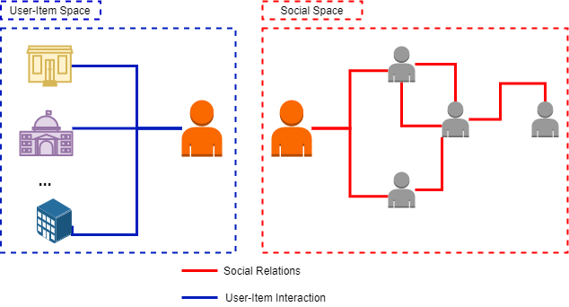
Social Recommender Systems
More recently, social recommender have taken the spotlight as these consider a user’s social presence when making predictions.
These systems are backed by social theories which argue that people are influenced by their social interactions and connections
Social Media: Followers, Following, Friends
A typical recommender system contains a user-item space; however, in social recommender, a user-user space is added alongside.
Notes:
Now that we know what recommender systems are, we can define what social recommendation is. These systems, known as social recommender systems integrate the users social interactions and information into the recommendation process. It is worth noting, the inclusion of social interactions is backed by social theories which argue that people are influenced by their social interactions.
In a typical recommender system, the model will contain a user-item space that will capture a users rating on items; however, in addition to that social recommenders contain a user-user space that represents a users relationship with other users. On the right-hand side, there is a diagram that represents these two components. We see that one user may rate many items and at the same time, they are connected to a whole set of users, known as their social relations or friends.

Slide 8
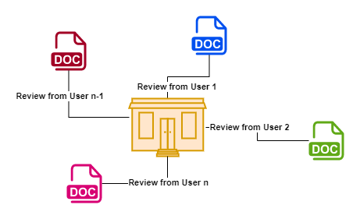
Our Contribution – Research gap
There is work done on Social Collaborative filtering [2] and Graph Neural Networks [1] for social recommendations.
We propose a deep neural network solution for social recommendations. (RevNet)
We seek to add another dimension to traditional social recommenders through the incorporation of user reviews (textual reviews) as a third space
The use of appropriate embedding techniques for user reviews
Notes:
There has been work done on social collaborative filtering as well as the utilization of GNN’s for social recommendations. However, we identify a gap wherein very little work has been done yin the social recommender domain, i.e the utilization of user reviews.
Thus, our contribution towards social recommender systems can be summarized as follows:
We propose a DNN solution for social recommendation.
Furthermore, we adding a user-review space where we seek to measure the effectiveness of text reviews provided by users on recommendations.
This is added as a third space alongside the user-item and user-user spaces.
We also consider appropriate embedding techniques for representing reviews in the NN and measure its effectiveness in the social recommender Domain.

Slide 9
3. Review of Previous Work
In this section, we will discuss some of the innovative architectures used for social recommendation, as well as review work that has incorporated textual user reviews.
Notes:
Very briefly, we will now discuss previous work done on social recommendations as well as review text representation techniques for user reviews

Slide 10
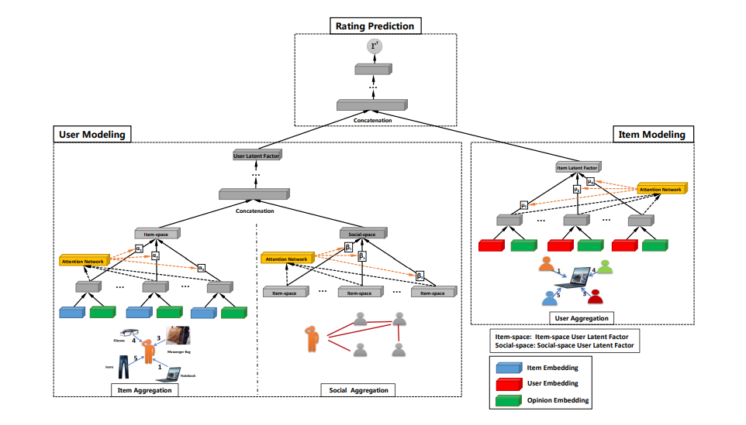
Graph Neural Networks for Social Recommendations [1]
The use of GNNs for social recommendation
User Modelling to learn user latent factors
Item aggregation and social aggregation.
Item Modelling to learn item latent factors
User aggregation
Rating Prediction
Concatenation of user and item latent factors
The researchers also wrote a paper on Social Collaborative filtering [2]
Notes:
In this paper, the researchers explored the use of Graph neural networks for social recommendation. The motivation behind the GNN, was that it can effectively integrate node information as well as effectively model the user-item and user-user spaces using a graph architecture.
This framework, called GraphRec, contains three components, user modelling, item modelling and rating prediction. Through user modelling, user latent factors are learnt On top of that, for the user modelling portion, they also introduce two aggregations, namely item aggregation and social aggregation, through which the combine the results for a single user latent factor representation.
For item modelling, item latent factors are learnt, through user aggregation, which aggregates a users’ opinion on items.
Rating prediction is facilitated through concatenation of user and item laten factors .
The researchers of this paper also wrote content on Social Collaborative filtering.

Slide 11
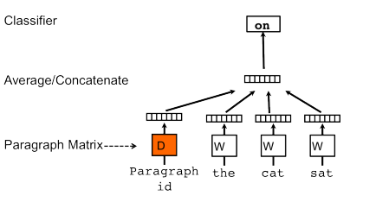
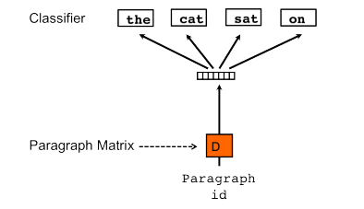
A Review of Text Representation Techniques for Recommender Systems
[3] discusses text-based recommender systems
For feature selection of text reviews, there are various techniques
Key word based
Letter Based
Semantic Features
Topic Modelling
Embedding
Doc2Vec [4] – Paragraph Vectors
Distributed Memory Model
Distributed Bag of Words
Distributed Memory Model
Distributed Bag of Words Model
Notes:
Now we focus on text representation techniques for incorporation into a recommender system. As seen on the slide, we summarize some of various different approaches for textual feature extraction, all of which are discussed in detailed in the linked paper.
For feature extraction we have key word-based feature selection which includes the TF-IDF approach which is commonly used in content based recommender systems. Letter based approaches use letters or a combination of letters such as bigrams/trigrams etc as input. Semantic features use key words only, the downside of which, is that we might not be able to exploit semantic attributes of the text.
Topic modelling approaches aim to produce topics/headings to specific pieces of short text. Latent Dirichlet Allocation is one such technique which can be used.
Embedding techniques seek to present the words into vectors of real numbers. Some approaches of word embeddings are Word2Vec, Fast Text and Glove
Doc2Vec, also known as paragraph vectors, is another approach which can be used to provide appropriate embeddings to a NN. Paragraph Vectors are capable of constructing representations of input text sequences of variable length. Unlike some of the previous approaches, it is general and applicable to texts of any length: sentences, paragraphs, and documents. It does not require task-specific tuning of the word weighting function nor does it rely on the parse trees. Regarding Doc2vec training, we have 2 approaches, namely the distributed memory model and the distributed bag of words model.

Slide 12
4. The Proposed Model
In this section, we focus on the design and architecture of the proposed RevNet model. In particular, we explore the various components of the model as well as define model parameters.
Notes:
This brings us to the proposed model.

Slide 13
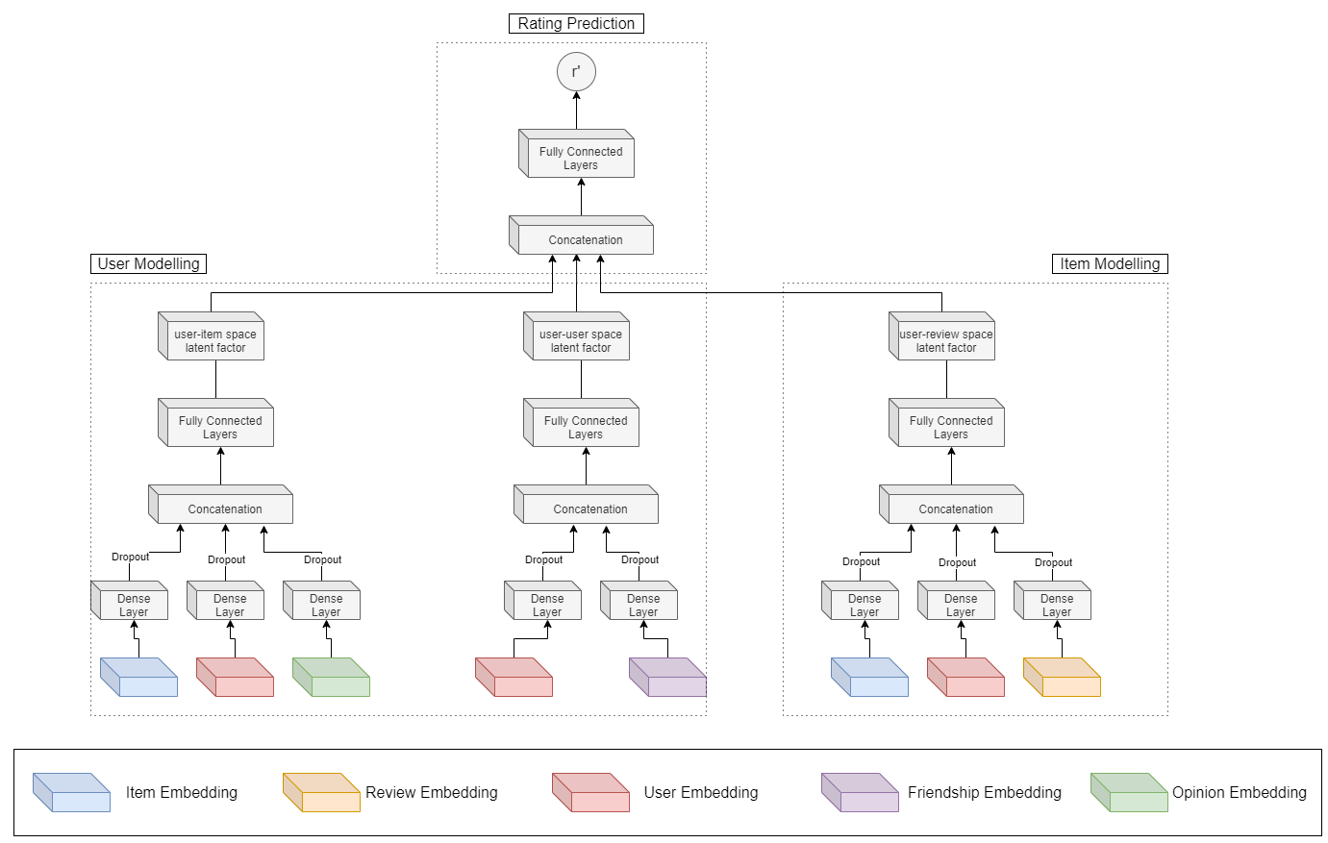
Architecture
Three main components.
User Modelling, Item Modelling and Rating prediction
The model contains user-item, user-user and user-review spaces
We learn latent factors from each of the spaces
Through concatenation, we obtain a final latent factor which is used for rating prediction
Notes:
As depicted in the Figure, the model contains three main components which are user modelling, item modelling and rating prediction. Furthermore, we derive latent representations from the user modelling and item modelling components, via their respective spaces.
User modelling seeks to understand users better, thus we facilitate this via the user-item and user-user spaces. Regarding user-item interactions, we propose appropriate embeddings to capture a user’s opinion on an item. Furthermore, as in a typical social recommender system, the social relationships are considered. This is done to model users from the social perspective. The outputs obtained from each of these spaces represent item user latent factors (h^{I}_{i}) and social user latent factors (h^{S}_{i}), respectively. We choose not to combine the obtained user latent factors into a single user latent factor representation.
The second component of the proposed architecture is item modelling. This is done through the consideration of text reviews and user opinion on items. Thus, we receive a latent factor representation (h^{R}_{i}) for the items.
Lastly, to facilitate rating prediction, we combine user and item modelling latent factor representations through concatenation, which is thereafter fed into subsequent neural network layers.

Slide 14
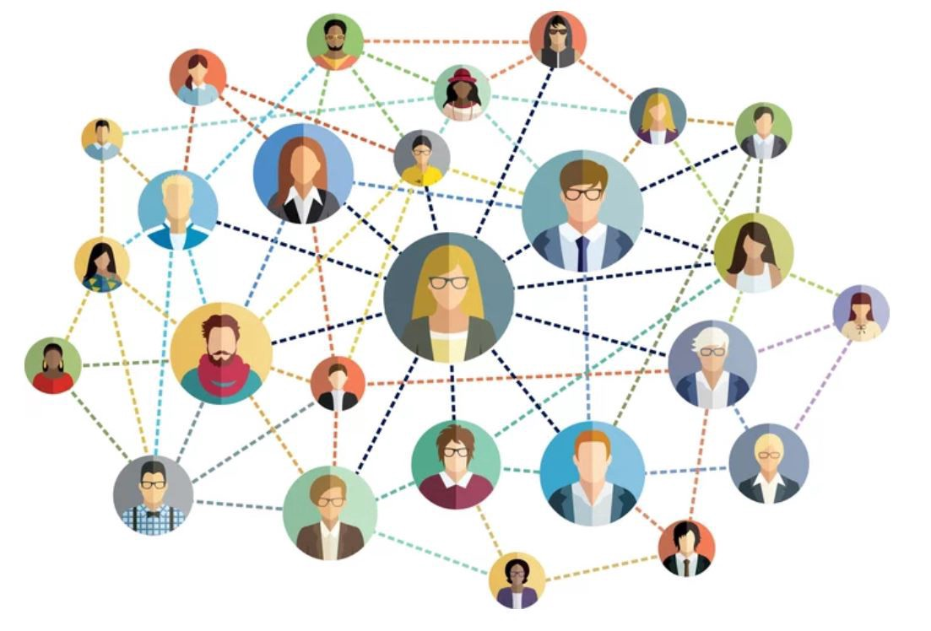
User Modelling
User-Item Space
Embed users, items and opinions
These embedding were fixed dimensions
Each embedding is individually passed into a dense layer
Concatenated and fed into a fully connected layer
Receive item space user latent factors
User-User Space
Embed users and their friends
Friendship embeddings were facilitated through doc2vec vector representations
Embedding dimensions for the friendship embeddings was d-dimensional
Similarly, these were passed into individual dense layers
Thereafter, concatenated and fed into a fully connected network
Receive social space user latent factors
Notes:
We will now look at the first major component of the proposed architecture, that is, user modelling.
The user modelling component is separated into two spaces namely the user-item and user-user spaces. In the user-item space, we embed users and items as well as an opinion that the user may have of the item. In this space, for each of the embedding, the dimension sizes were fixed. Thereafter, these representations are passed into individual dense layers before being concatenated and fed into a fully connected set of layers. The output from the user-item space represents the item user latent factors.
In the social space, we represent the users along side their friends. We do this using through user embedding as done in the user-item space as well as include an embedding of their friends. It becomes computationally expensive to create a sparce matrix of one hot encoded values to represent friendship. Thus, to counter this problem, we used doc2vec vectors for friendship embeddings. This also allowed us to reduce the dimensions. The embedding dimensions used for friendships was d-dimensional and not fixed. Similarly, these representations were passed into individual dense layers, and thereafter concatenated and fed into a fully connected set of layers. The result from this process resulted in social space user latent factors. We choose not to combine the user latent factors into a single value.

Slide 15

Item Modelling
Learn Item Latent Factors
Contains the user-review space for incorporation of user reviews.
Embedding of users, items and opinions follow the same procedure as previously discussed.
Use the Doc2vec model for text embeddings
Text preprocessing is done before feeding it to the model.
d-dimensional review embeddings
Notes:
In the item modelling component of the system, we seek to learn item latent factors. More importantly, this is the component of the solution that integrates a users textual review into the system. In this portion, we embed user, items, reviews and user opinion. The embedding of users, items and opinions were facilitated in the same way discussed in the previous slide.
For text embedding, we employed the use of the Doc2Vec model. First, we pre-process the review to ensure that we have a denoised text review which carries the important aspects. There after, we pass the cleaned review into the doc2vec model for vector representation. The embedding obtained from the model is d-dimensional as we experiment with the dimension size during experimentation.

Slide 16
Text Pre-Processing Pipeline
Lowercase Conversion
Convert the text to lowercase for uniformity
Stop word removal
Stop words are words that occur frequently such as “a” and “and”, which don’t carry meaningful information
Hashtag Removal
Remove the hashtags that are appended to words
Punctuation Removal
Lemmatization
Coverts a word into its base form whilst taking into consideration the context in which it appears
Remove punctuation to reduce the overall noise present in the text
Notes:
In this slide, we will briefly highlight the text pre-processing pipeline used to clean the user reviews.
User reviews in their raw state contain many words that are not helpful to our NLP task. These include the likes of stop words and hashtags. Thus, we follow a pre-processing pipeline through which we seek to uniformly represent our data and improve its appropriateness for the NLP task at hand.
The first step in our pre-processing pipeline was to convert the entire review into lower case. Through this, case uniformity is established, and as a result, case sensitivity will not be an issue when conducting future text operations. The next operation carried out is stop word removal. Stop words are words, such as “and”, “a” and “is”, that occur frequently throughout a text, which carry very little meaningful information. Thus, the removal of stop words reduce the overall word count and allow us to focus on the words that carry meaningful semantic information. Thereafter, the removal of hashtags was done. We then moved on to the removal of punctuation marks. All of the removal operations contribute significantly to the overall representation of the text, as it removes unneeded data and reduces the overall noise.
The last operation in our pre-processing pipeline was normalization through Lemmatization. Lemmatization converts a word to its base form; however, it considers the context in which the word appears and provides a meaningful base form.

Slide 17

Rating Prediction
Obtain latent factors from the user-item, user-user and user-review spaces.
Combine the latent factors through vector concatenation to obtain a single latent factor representation.
Latent factor is passed into two further layers
4 Neurons
1 Neuron
Receive the predicted rating as output
Used the LeakyReLU activation function
Notes:
Rating prediction formed the last component of the model. Herein, we combine all of the obtained latent factors into a single latent factor representation. The combination of latent factors was facilitated through concatenation. Thereafter, we pass this value into two further layers, one containing 4 hidden neurons and the other containing one neuron. The output received is the predicted rating.

Slide 18
Model Training
Mean Squared Error (MSE) Loss function
Adam optimizer
Smooth path to the global minimum
Small learning rate of 0.001
Through experimentation, this value was varied
Dropout of 0.2 to avoid overfitting
Fixed embedding dimensions for users, items and opinions
Varied d-dimensional embeddings for reviews and friendships
Early stoppage after 20 epochs
Notes:
The final aspect of this section involves model training. Apart from the overall architecture and design, there is a need to combine the model with appropriate loss functions and optimizers.
The objective function that we seek to minimize is the Mean Squared Error. We also adopt the use of the Adam optimizer because it gives us a smooth path towards the local minimum. We also set the learning rate of the model to be 0.001; however, we experiment with this value in the subsequent section. To avoid overfitting, which is prevalent in NNs, we utilized a dropout rate of 0,2.
Regarding embeddings, as stated earlier the user, item and opinion embeddings were fixed dimensions whereas friendship and review embeddings were d-dimensional.
Lastly early stoppage was utilized to stop the model if no improvements have been made in minimizing the validation loss after 20 epochs.

Slide 19
5. Evaluation
In this section, we provide an unbiased critique of the proposed model. Furthermore, we compare its results to two benchmark models.

Slide 20
Experimental Settings
DataSet
Evaluation Metrics
Benchmarking and parameter settings
Yelp Dataset
Ratings provided from users in the range [1, 5]
For experimentation, we read in 1000 users, 10 000 reviews and 160 585 businesses
Offline analytics
Accuracy
MAE
RMSE
Mod-RevNet: user-item space
Soc-RevNet: user-item, user-user spaces
80% Training data, 5% validation, 20% testing
Doc2Vec dimensions {32, 64, 128, 256}
Batch sizes {64, 256}
Learning rate {0.005, 0.001, 0.05, 0.01}
Notes:
We will begin the evaluation portion of this presentation by looking at the dataset used, evaluation metrics adopted, a brief analysis of the structure of the benchmarking models as well as define the parameter settings. We adopted a real world dataset to evaluate our model on. This is the Yelp dataset which contains over 2 million users and over 8 million reviews. The ratings provided by users were in the range of 1 to 5. Since computation of friendship relations and text embeddings can be very consuming, we read in 1000 users, 10 000 reviews and the full business dataset.
For the evaluation metrics, we adopted MAE and RMSE. Smaller values for these metrics would indicate that the model is performing well. On top of that we employed the use of Accuracy. For accuracy, we rounded the values we obtained from the NN and compared to the true rating. Typically we would utilise accuracy alongside precision and recall to identify if there are any class imbalances; however, we did not use these metrics.
Regarding benchmarking, we used two variants of the RevNet model. The first is Modified RevNet, Mod-RevNet, which contains no social space and no user review space for review incorporation. The second variant is the Social-RevNet, which contains the user item space and the user-user space. Common between both variants is that they do not have any review embeddings. We have established that the current state of the art is social recommenders and hence why having the second variant is important.
For experimentation, we used 80% of the data for training and 20% for testing. From the training data, 5% was held back for validation. As discussed earlier, we varied the dimensions of the friendship and review embeddings. These we tetested on 32, 64, 128, and 256 dimensions. We also varied the batch rates between 64 and 256. Lastly, the last parameter constantly tweaked was the learning rate which ranged form 0,005, 0,001, 0,05, 0,01.

Slide 21
Model Analysis
Model Performance on increased batch size
Distributed Memory VS Distributed BOW Review Embeddings
Increased dimension size does not adversely affect model performance
Model underperforms with a too high learning rate
Both embedding techniques provide similar results
Distributed BOW trains faster and produces better results in outlier cases
Model scales well with larger batch sizes
Using either embedding technique does not affect the performance
Large batch sizes with optimal learning rate values scale well
Notes:
In this slide we highlight the performance of the proposed model. We also compare the two text embedding techniques used. As explained earlier, changes to embedding sizes, learning rates and batch sizes were done. From those alterations we arrived with the following conclusions.

Slide 22
MAE and RMSE Comparison on Varied Learning Rates

Slide 23
Increased Batch Size Comparison
Distributed Memory
Parameters |  |  | Metrics
Embedding Size | Learning Rate | Batch Size | MAE | RMSE | Accuracy
32 | 0.001 | 64 | 0.18 | 0.25 | 0.975
64 | 0.005 | 64 | 0.09 | 0.15 | 0.98
128 | 0.05 | 64 | 1.38 | 1.7 | 0.225
256 | 0.01 | 64 | 0.1 | 0.19 | 0.97
Distributed Bag of Words
Parameters |  |  | Metrics
Embedding Size | Learning Rate | Batch Size | MAE | RMSE | Accuracy
32 | 0.001 | 64 | 0.15 | 0.22 | 0.97
64 | 0.005 | 64 | 0.15 | 0.21 | 0.97
128 | 0.05 | 64 | 0.47 | 0.58 | 0.635
256 | 0.01 | 64 | 0.076 | 0.15 | 0.975
Distributed Memory
Parameters |  | Metrics
Embedding Size | Batch Size | MAE | RMSE | Accuracy
32 | 256 | 0.13 | 0.21 | 0.963
64 | 256 | 0.112 | 0.21 | 0.9635
128 | 256 | 0.15 | 0.2313 | 0.9545
256 | 256 | 0.118 | 0.207 | 0.9625
Distributed Bag of Words
Parameters |  | Metrics
Embedding Size | Batch Size | MAE | RMSE | Accuracy
32 | 256 | 0.14 | 0.2228 | 0.9625
64 | 256 | 0.13 | 0.212 | 0.9625
128 | 256 | 0.1 | 0.1978 | 0.9645
256 | 256 | 0.122 | 0.2034 | 0.965

Slide 24
Performance Comparison
Compared against two benchmark models
Mod-RevNet: Contains only the user-item space
Soc-RevNet: Contains user-user and user-item spaces
The Mod-RevNet model does not perform as well as the RevNet Model
Soc-RevNet performance is similar to the performance of RevNet
On high learning rates, both Mod-RevNet and Soc-RevNet fail to perform adequately.
RevNet outperforms both models in higher learning rate experiments
Conclude that social relations are important as well as user reviews in rating prediction
Notes:
In the previous slide, we demonstrated the effectiveness of the proposed architecture on the Yelp dataset. The model contained components for latent factor representation learning in which we obtained item space user latent factors (h^{I}_{i}), social space user latent factors (h^{S}_{i}) and review space item latent factors (h^{R}_{i}).

Slide 25
Model | MAE | RMSE | Accuracy
Distributed Memory RevNet | 0.09 | 0.15 | 0.98
Distributed BOW RevNet | 0.15 | 0.21 | 0.97
Mod-RevNet | 0.42 | 0.5 | 0.5935
Soc-RevNet | 0.05 | 0.18 | 0.9615
Notes:
From the comparison of the three models, we have the following conclusions (i) Friendship embeddings used in a social recommender are effective, (ii) The incorporation of user reviews into a social recommender system does not deteriorate the performance of a social recommender, but rather adds another dimension wherein the model may succeed where a traditional social recommender fails, (iii) There is no convincing evidence that a social recommender system with user reviews is better than a standard social recommender.
Regarding conclusion (i), the use of the social space friendship embeddings for latent factor representation learning is effective and provides a boost to output recommendation performance. We saw a substantial decrease in MAE and RMSE in the Soc-RevNet model compared to the Mod-RevNet model with the introduction of the user-user space. This is further re-iterated in [3], where it has been proven that social relations contained in the user-user space, enhances the performance of the model by being able to learn more effective user latent factor representations as compared to other benchmarks.
Conclusion (ii) regards our contribution towards the social recommender domain. The use of doc2vec embedding techniques to represent user reviews is appropriate, as similar semantically related reviews will have a similar vector representation. Thus, providing a way for the model to understand when a review is good or not and providing an appropriate rating prediction. This is exemplified in the performance comparison between RevNet and Soc-RevNet. Although Soc-RevNet generally has better MAE and RMSE performance, the accuracy achieved by adding review embeddings is worth between one to two percent. Furthermore, the incorporation of user reviews provides better performance on higher learning rates where its variant counterparts fail to perform.
Lastly, in (iii), we state that there is no convincing evidence to suggest that one social recommender model is always better than the other. This conclusion is regarding RevNet and Soc-RevNet specifically. Moreover, we concur that both spaces, user-user and user-review, play an important role in improving output predictions in a recommender model. This statement stands as the absence of the relevant spaces in the Mod-RevNet model deteriorates the overall performance. Regarding Soc-RevNet and RevNet specifically, we saw results in favour of both models where experimental settings were equivalent. In on the slide, where experimental settings are the same, the performance of both models are similar in magnitude. In particular, the Soc-RevNet model has better MAE and RMSE values, whilst the RevNet model has a better output accuracy.

Slide 26
6. Conclusion and Future Work

Slide 27

Conclusions and Future Work
In this research project, we have presented a model that incorporates user reviews into a social recommender system. We evaluated its performance against 2 benchmark models and concluded that the inclusion of user reviews can be helpful and aids in rating prediction. To the foregoing, future work in this domain can include the incorporation of user profile data and other rich information that may be available. Furthermore, the use of other neural network architectures can be adopted, and their effectiveness evaluated in the recommender domain. Thus, an extension to this research would be to convert the fully connected architecture into a graph neural network architecture.
Notes:
In this research project, we have presented a novel deep neural network model (RevNet), that utilises user reviews for social recommendation. In particular, the model was designed for item rating prediction. We have provided components for the incorporation of user-item interactions, user-user interactions as well as employed and evaluated the use of doc2vec paragraph representations for review embeddings into the neural network. Experimental results on the Yelp dataset shows that the model performs rather well. Furthermore, RevNet significantly outperforms a modified version of the model, where the user-user and user-review spaces were removed. When compared to a second benchmark, that is the variant that contained social relations, we saw that the model performed equally well, outperforming it in accuracy but underperforming in MAE and RMSE.
To the foregoing, future work in this domain can include the incorporation of user profile data and other rich information that may be available. Furthermore, the use of other neural network architectures can be adopted, and their effectiveness evaluated in the recommender domain. Thus, an extension to this research would be to convert the fully connected architecture into a graph neural network architecture.

Slide 28
7. Acknowledgements and References

Slide 29
Acknowledgements
references
Dr Edgar Jembere
National Research Fund
University of KwaZulu-Natal’s Astrophysics Department for access to HIPPO
W. Fan et al., “Graph Neural Networks for Social Recommendation,” The World Wide Web Conference on - WWW ’19, 2019, doi: 10.1145/3308558.3313488.
W. Fan, Y. Ma, D. Yin, J. Wang, J. Tang, and Q. Li, “Deep Social Collaborative Filtering,” doi: 10.1145/3298689.3347011.
S. Kanwal, S. Nawaz, M. K. Malik, and Z. Nawaz, "A Review of Text-Based Recommendation Systems," IEEE Access, vol. 9, pp. 31638–31661, 2021, doi: 10.1109/access.2021.3059312.
Q. Le and T. Mikolov, “Distributed Representations of Sentences and Documents,” 2014. Accessed: May 11, 2021. [Online].

Slide 30
8. Software Demonstration
In this section, we will walk through the execution of the proposed model, as well as run through the different phases and finally show the resultant output.

Slide 31

Thank You
Ahmad Jawaad Shah
218029400@stu.ukzn.ac.za
Project Repository: https://github.com/ahmadj1801/Using-User-Reviews-to-Enrich-Social-Recommender-Systems
Notes:
This concludes my presentation. My details are on screen if needed. The link to the project repository is also included. Please note that the project is hosted on GitHub and does not include the dataset. The dataset can be downloaded separately. Thank you for your time.

